Slide 1
Ajax, XML, and JSON
By Jinzhu Gao

Slide 2
Objectives
Learn to inject new data into an existing web page using Ajax

Slide 3
Web Applications
Web application: a web site that mimics the look, feel, and overall user experience of a desktop application
a web app presents a continuous user experience rather than disjoint pages
as much as possible, "feels" like a normal program to the user
Examples of web apps
Gmail, Google Maps, Google Docs and Spreadsheets, Flickr, A9
Many web apps use Ajax to battle these problems of web pages:
slowness / lack of UI responsiveness
lack of user-friendliness
jarring nature of "click-wait-refresh" pattern

Slide 4
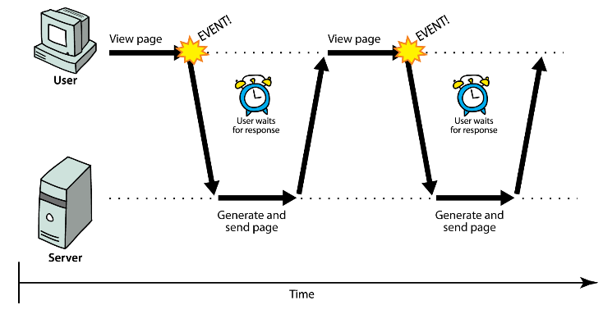
Synchronous Communication
User must wait while new pages load (click, wait, refresh)

Slide 5
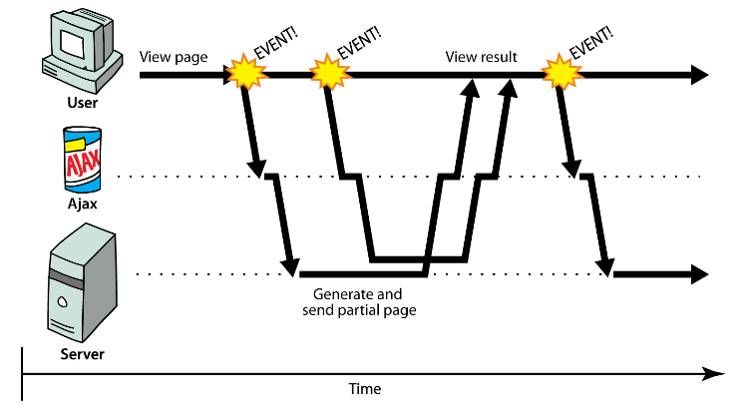
Asynchronous Communication
User can keep interacting with page while data loads

Slide 6
Ajax
Asynchronous JavaScript and XML
A way to dynamically update a page using data fetched from a web server
Not a programming language; a particular way of using JavaScript
Downloads data from a server in the background
Allows dynamically updating a page without making the user wait
Aids in the creation of rich, user-friendly web sites
examples: Practice-It; Google Suggest

Slide 7
Core Concept
JavaScript's XMLHttpRequest object can fetch files from a web server
supported in IE5+, Safari, Firefox, Opera, Chrome
It can do this asynchronously (in the background, transparent to user)
Contents of fetched file can be put into current web page using DOM
Result: user's web page updates dynamically without a page reload

Slide 8
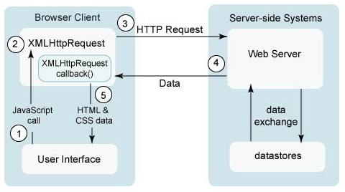
A Typical Ajax Request
Notes:
1. user clicks, invoking event handler
2. that handler's JS code creates an XMLHttpRequest object
3. XMLHttpRequest object requests a document from a web server
4. server retrieves appropriate data, sends it back
5. XMLHttpRequest fires event to say that the data has arrived
this is often called a callback
you can attach a handler to be notified when the data has arrived
6. your callback event handler processes the data and displays it

Slide 9
Using XMLHttpRequest (10.2)
Methods:
abort, getAllResponseHeaders, getResponseHeader, open, send, setRequestHeader
properties:
onreadystatechange, readyState, responseText, responseXML, status, statusText
IE6 doesn't follow standards and uses its own ActiveXObject instead
we'll learn to use Ajax in 4 steps:
synchronous, text-only
asynchronous, text-only
asynchronous w/ Prototype
asynchronous w/ XML data (real Ajax)

Slide 10
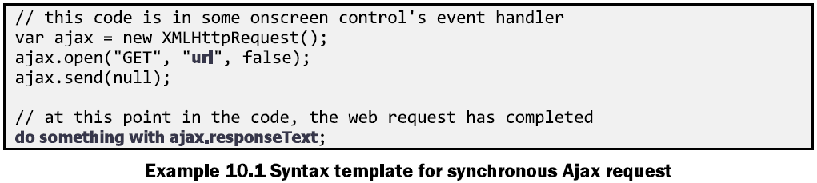
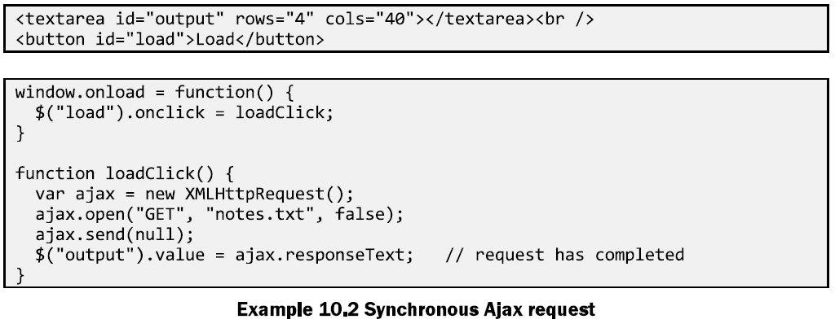
Synchronous Requests
Notes:
Ajax.send(null): waits for the request to finish before returning
Bad things:
your code waits for the request to completely finish before proceeding
easier for you to program, but ...
the user's entire browser locks up until the download is completed
a terrible user experience (especially if the file is very large)

Slide 11
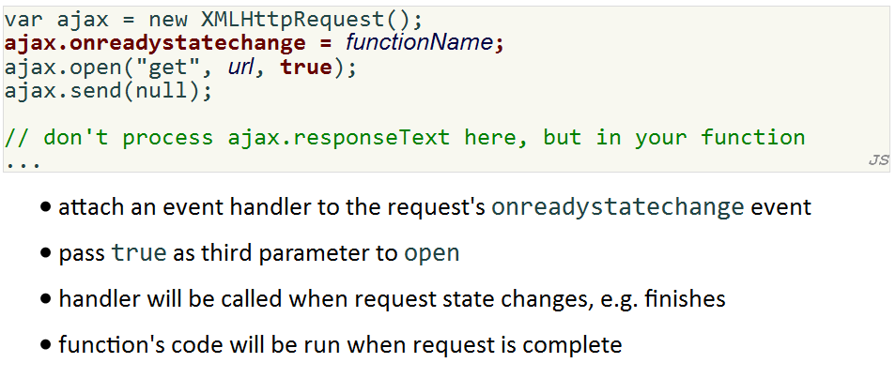
Asynchronous Requests
Notes:
Pass true as third parameter: the send method returns immediately rather than it waiting for the request to be completed before returning

Slide 12
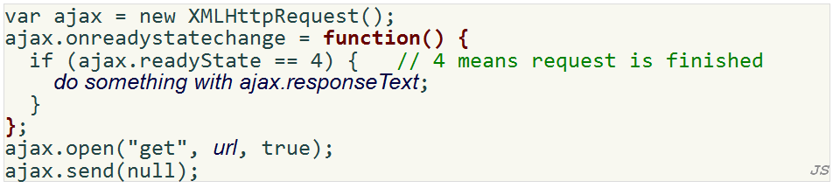
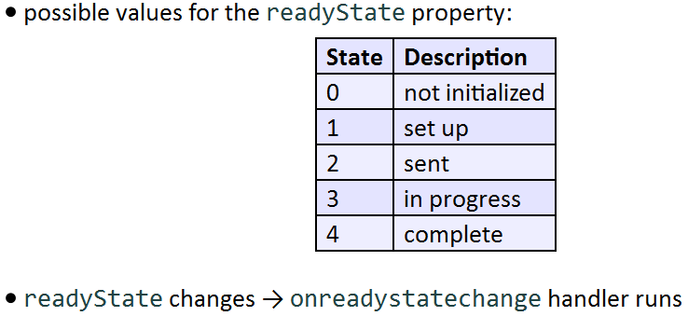
Asynchronous Requests

Slide 13
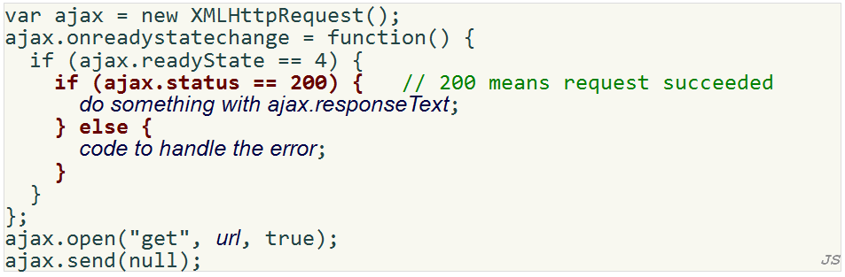
Asynchronous Requests

Slide 14
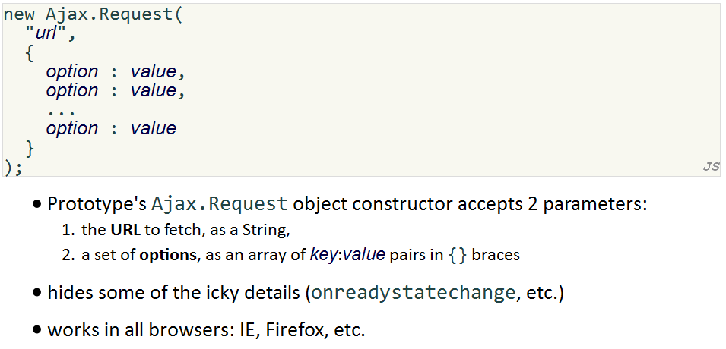
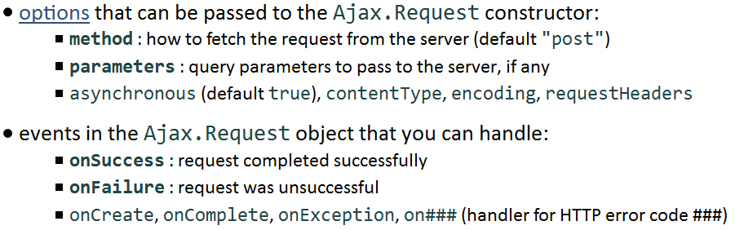
Prototype’s Ajax Model

Slide 15
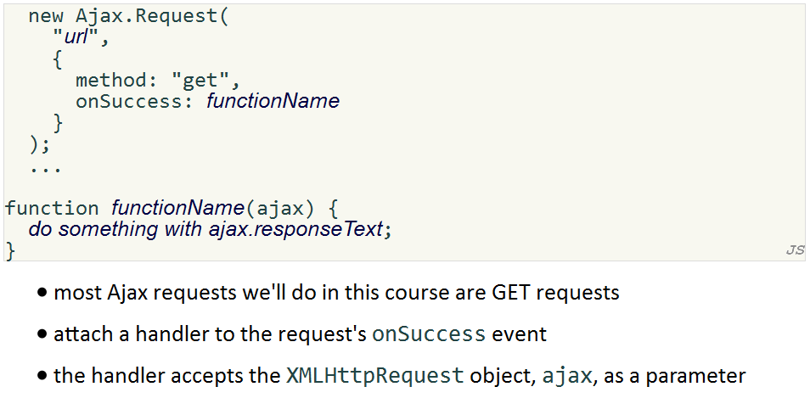
Prototype’s Ajax Model

Slide 16
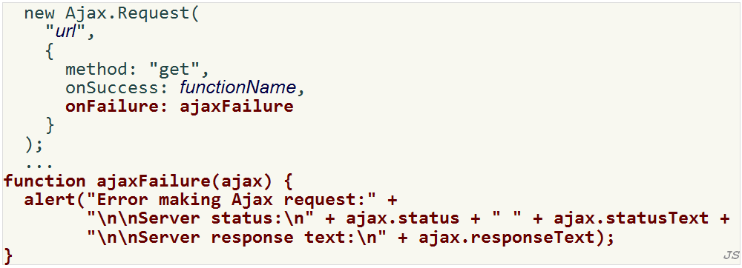
Prototype’s Ajax Model – Error Handling

Slide 17
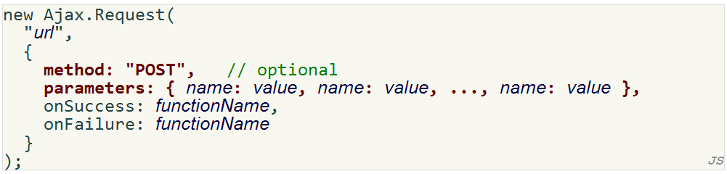
Prototype’s Ajax Model – Create a POST request

Slide 18
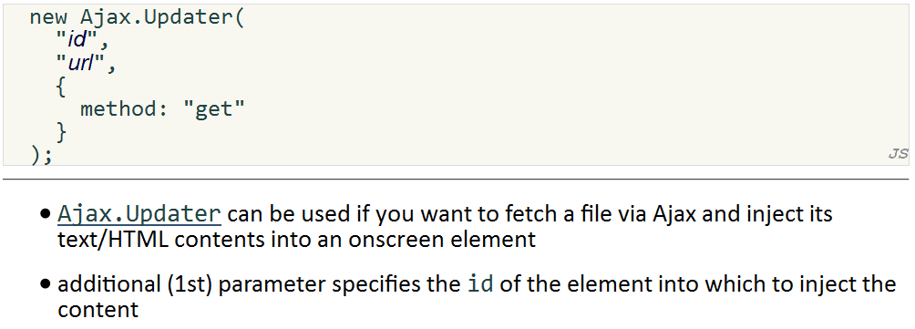
Prototype’s Ajax Model – Ajax Updater

Slide 19
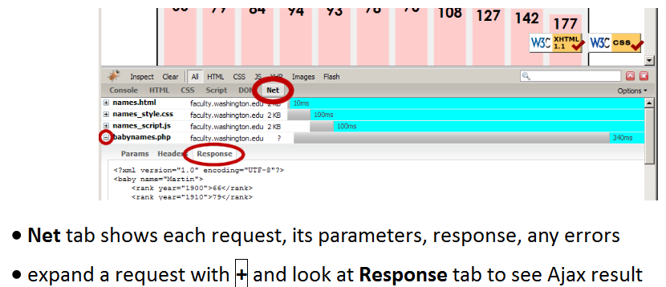
Debugging Ajax Code

Slide 20
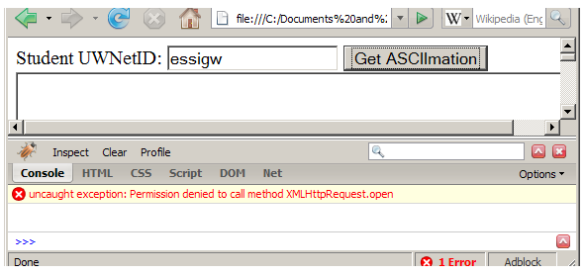
XMLHttpRequest Security Restrictions
cannot be run from a web page stored on your hard drive
can only be run on a web page stored on a web server
can only fetch files from the same site that the page is on
www.foo.com/a/b/c.html can only fetch from www.foo.com

Slide 21
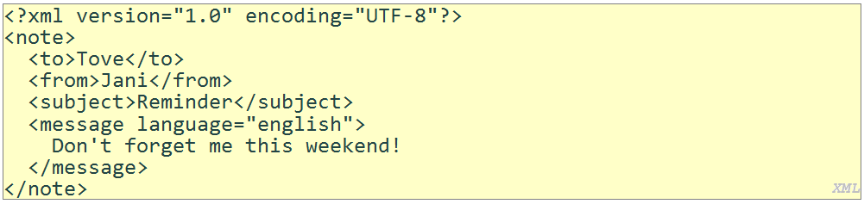
XML (10.3)
A specification for creating languages to store data; used to share data between systems
a basic syntax of tags & attributes
languages written in XML specify tag names, attribute names, and rules of use
Example: XHTML is a "flavor" of XML
an adaptation of old HTML to fit XML's syntax requirements
XML specifies tag syntax: <... ...="..."></...>
HTML contributes tag names (e.g. h1, img) and attributes (id/class on all elements, src/alt on img tag)

Slide 22
XML Tags
any tag you want; the person storing the data can make up their own tag structure
example: a person storing data about email messages may want tags named to, from, subject
example: a person storing data about books may want tags named book, title, author
"Garden State" XML: if you're feeling unoriginal, make up some XML nobody's ever done before
<bloop bleep="flibbetygibbet">quirkleblat</bloop>

Slide 23
XML Schemas
schema:
an optional set of rules specifying which tags and attributes are valid, and how they can be used together
used to validate XML files to make sure they follow the rules of that "flavor"
XHTML has a schema; W3C validator uses it to validate
doctype at top of XHTML file specifies schema
Two ways to define a schema:
Document Type Definition (DTD)
W3C XML Schema

Slide 24
Use of XML
XML data comes from many sources on the web:
web servers store data as XML files
databases sometimes return query results as XML
web services use XML to communicate
XML languages are used for music, math, vector graphics
Popular use: RSS for news feeds & podcasts

Slide 25
Pros and cons of XML
pro:
easy to read (for humans and computers)
standard format makes automation easy
don't have to "reinvent the wheel" for storing new types of data
international, platform-independent, open/free standard
can represent almost any general kind of data (record, list, tree)
con:
bulky syntax/structure makes files large; can decrease performance
example: quadratic formula in MathML
can be hard to "shoehorn" data into an intuitive XML format
won't need to know how for this class

Slide 26
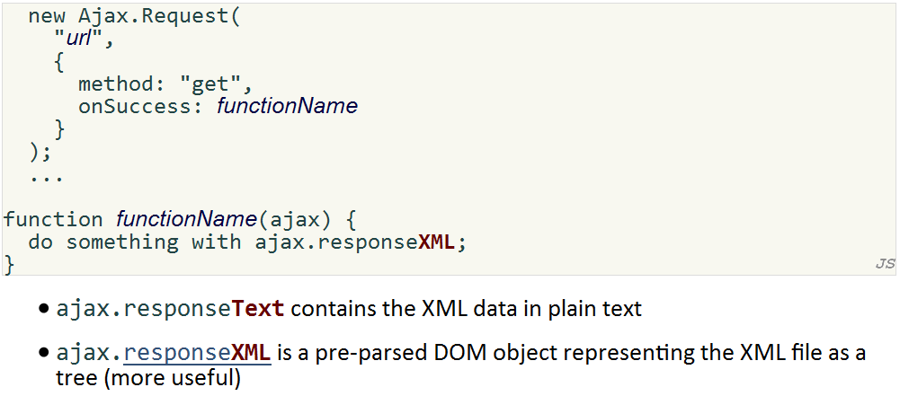
Fetching XML Using AJAX

Slide 27
Using XML Data in a Web Page
custom flavor of XML needs to be converted to XHTML, then injected into page
we will transform using Javascript XML DOM
basic technique:
fetch XML data using Ajax
examine the responseXML object, using DOM methods and properties
extract data from XML elements and wrap them in HTML elements
inject HTML elements into web page
other ways to transform XML (not covered): CSS, XSLT

Slide 28
JS XML (XHTML) DOM
All of the DOM properties and methods we already know can be used on XML nodes:
properties:
firstChild, lastChild, childNodes, nextSibling, previousSibling, parentNode
nodeName, nodeType, nodeValue, attributes
methods:
appendChild, insertBefore, removeChild, replaceChild
getElementsByTagName, getAttribute, hasAttributes, hasChildNodes

Slide 29
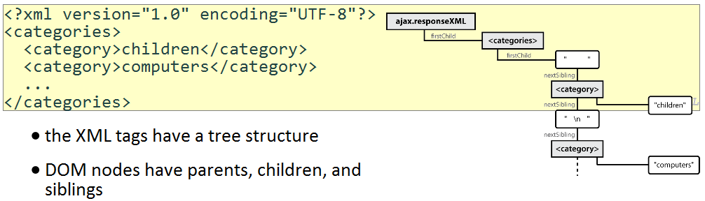
XML DOM Tree Structure

Slide 30
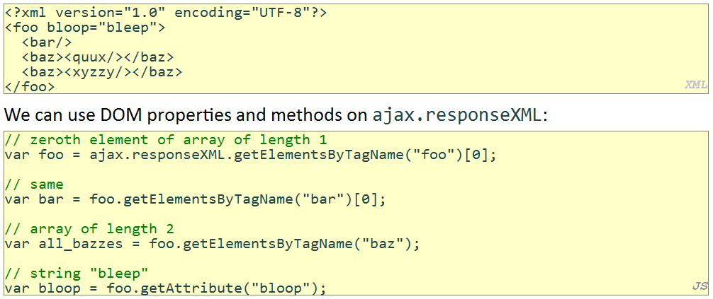
Analyzing a Fetched XML File Using DOM

Slide 31
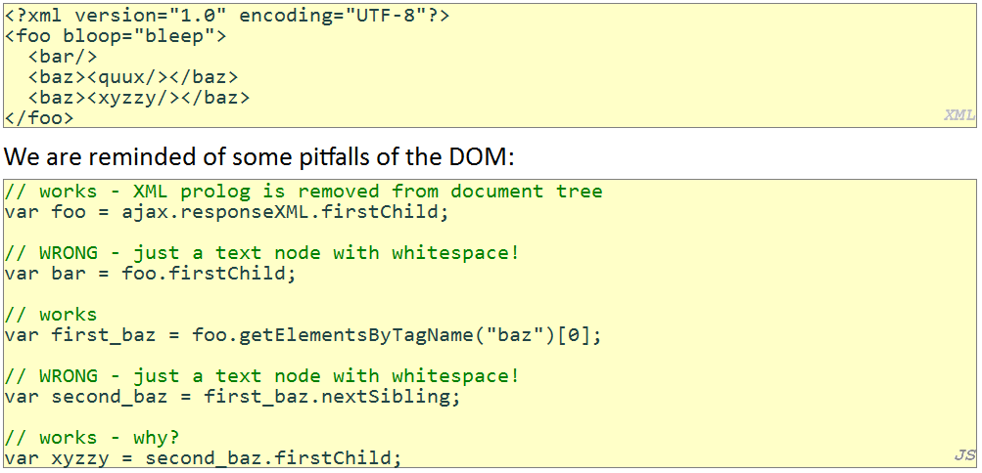
Pitfalls of the DOM

Slide 32
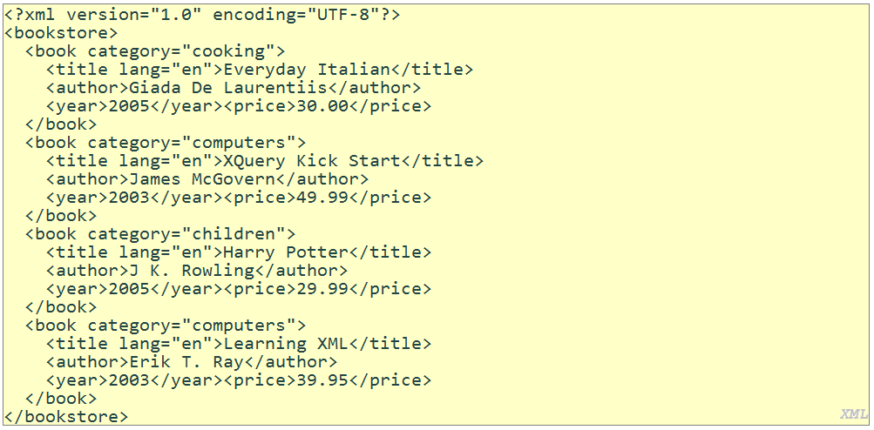
XML Example

Slide 33
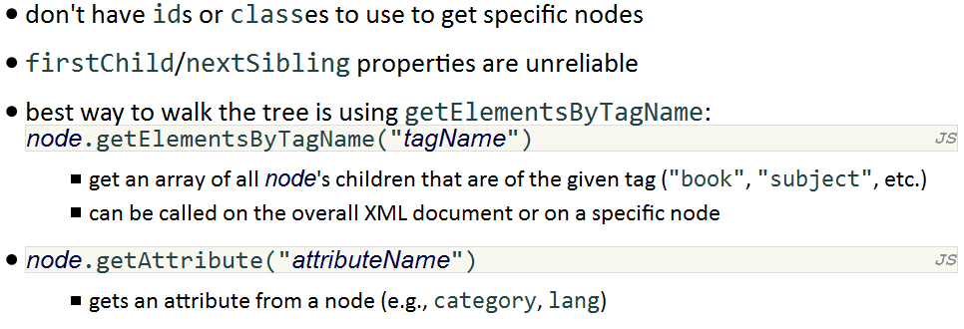
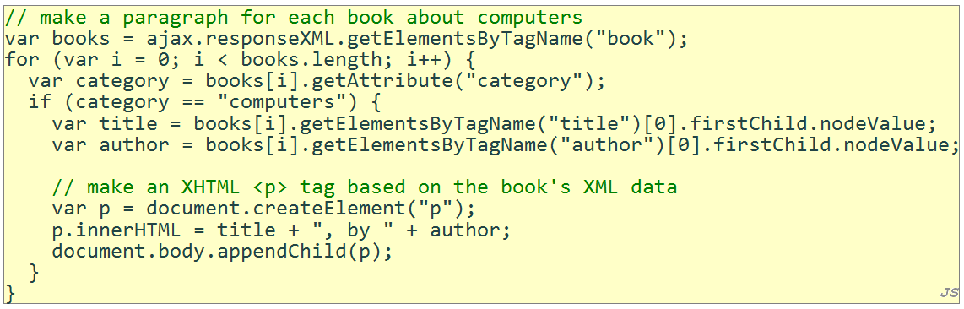
Navigating the Node Tree

Slide 34
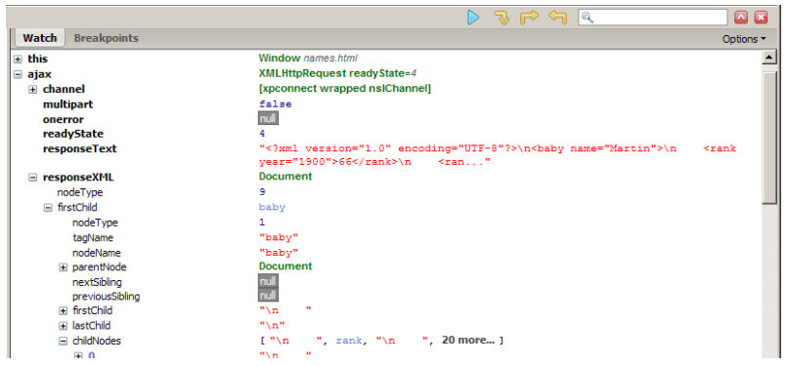
Debugging responseXML in Firebug
can examine the entire XML document, its node/tree structure

Slide 35
JSON
JavaScript Object Notation (JSON)
A technique for exchanging data by encoding it as text similar to the declaration of a set of JavaScript objects
Similar to XML
Sidestep shortcomings of XML
JSON data is shorter and less cluttered
JSON data is simpler to create, read, and write
JSON data can be fully parsed using built-in JavaScript commands without the need for a separate DOM

Slide 36
JavaScript Object Literals
{
fieldName: value,
fieldName: value,
…
fieldName: value
}

Slide 37
Declaring and Using a JavaScript Object
var person = {
name: “Philip J. Fry”,
age: 23,
weight: 172.5,
friends: [“Farnsworth”, “Hermes”, “Zoidberg”],
getBeloved: function() {return this.name + “ loves Leela”; }
};
alert(person.age); // 23
alert(person[“weight”]); // 172.5
alert(person.friends[2]); // Zoidberg
alert(person.getBeloved()); // Philip J. Fry loves Leela

Slide 38
Chat Log Data in XML
<?xml version=“1.0” encoding=“UTF-8”?>
<messages>
<message time=“1:57” sender=“Jessica Miller”>
so do we have a title for the book yet?
</message>
<message time=“1:58” sender=“Marty Stepp”>
i was hoping we’d use one that is a pun on my name?
</message>
<message time=“2:03” sender=“Jessica Miller”>
sheesh
</message>
</message>

Slide 39
Chat Log Data in JSON
{
“messages”: [
{
“time”: “1:57”,
“sender”: “Jessica Miller”,
“body”: “so do we have a title for the book yet?”
},
{
“time”: “1:58”,
“sender”: “Marty Stepp”,
“body”: “i was hoping we’d use one that is a pun on my name?”
},
{
“time”: “2:03”,
“sender”: “Jessica Miller”,
“body”: “sheesh”
}
]
}

Slide 40
Fetching JSON Data Using Ajax.Request
function handleJsonData() {
new Ajax.Request(“chatlog.php?data=20120219”,
{
method: “GET”,
onSuccess: ajaxSuccess,
onFailure: ajaxFailed,
onException: ajaxFailed
}
);
}

Slide 41
Parsing and Using JSON Data
function ajaxSuccess(ajax) {
var data = JSON.parse(ajax.responseText);
alert(data.messages[0].time); // 1:57
alert(data.messages[2].sender); // Jessica Miller
alert(data.messages.length); // 3
for (var i = 0; i < data.messages.length; i++) {
alert(“Message from ” + data.messages[i].sender + “ at ”
data.messages[i].time + “: ” + data.messages[i].body);
}
}

Slide 42
Summary
Ajax Concepts
Using XMLHttpRequest
XML
JSON

